Slide 1

My Market Monitor 3.0
The way forward
May 2011
Global Commercial IT, Abhishek Avasthi

Slide 2

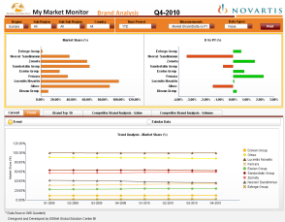
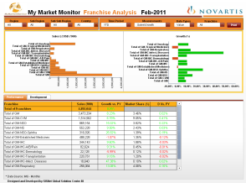
Current My Market Monitor Needs to be relooked at from usability standpoint
What is it good at?
Measuring regional business performance based on Global IMS Sales data
Visual representations & fast offline access
What are the shortcomings?
Not available online and lacks related features
Requires different .pdf download with high download size, time & clicks!
Doesn’t report promotional data measures
Not compatibility with iPad
MMM Reports (Mthly & Qtly)
Competition Analysis
Franchise Analysis
Regional Analysis
Brand Analysis
Brand Top 10 Analysis
Competitor Brand Analysis
MMM on MS Knowledge Net

Slide 3

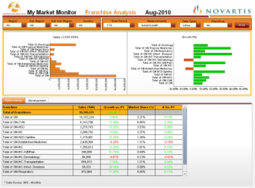
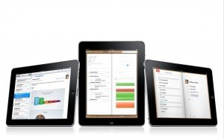

My Market Monitor 3.0 Brings you added measures, better features & efficient access
Additional data scope
Promotional data measures (SOV, Details etc.)
Medical data measures (Sales split by brand diagnosis etc.)
Additional time periods (5Y monthly development etc.)
Qualitative measures
Financial data integration & related measures
Enhanced features & efficient access
Available online, with Single Sign On
iPad compatible (individual app in phase 3)
Personalized access (My Brand, My CPO, bookmarks etc.)
Share reports with other users (send emails with report)
Set individual alerts (send me ‘My Brand’ report each month etc.)
Enhanced performance (speedy report generation, access etc.)

Slide 4
My Market Monitor 3.0 Challenges & Next Steps
Challenges
Communication
Efficient communication required for Business Franchise & CPO user communities
Marketing for My Market Monitor 3.0!
Usage
Somewhat linked to enhanced features & ease of access
Track usage for improvements
What’s Next?
MMM Roadmap
Requirements analysis & documentation
Vendor agreement & engagement planning
Develop, Test & Deploy the MMM 3.0
Communicate & train users
Tentative first roll out by end of Q3 2011

Slide 5






My Market Monitor 3.0 Phased approach to reach the objectives of MMM 3.0
Phase 1
Phase 2
Phase 3
Medical/ Rx Measures
iPad application! Details to be worked out
Additional measures (promotional & medical) included??
Email report & configure alerts
Maintain performance considering inc. in data scope
Online version of current MMM
Single Sign On
Personalized access – ability to define preferences on BFs, Regions & Brands
Export to .pdf, .ppt & .xls
Compatible with Safari/ iPad

Slide 6
Backup

Slide 7
My Market Monitor 2.0... Current Scope...
1
Overview Analysis
2
Brand/ Brand Group Analysis
3
Competition Analysis
Measures
Sales, Growth, Market Share, Delta vs PY
Data Types
Value & Volume
Geography
Region, Sub Region, Sub Sub Region & Country
Time Period
Current Month/ Quarter - YTD, MAT & Trend
Measures
Sales, Growth, Market Share, Delta vs PY
Data Types
Value & Volume
Geography
Region, Sub Region, Sub Sub Region & Country
Time Period
Current Month/ Quarter - YTD, MAT & Trend
Competitors (Chart/ Table)
Business Franchise (Chart/ Table)
Measures
Sales, Growth, Market Share, Delta vs PY
Data Types
Value & Volume
Time Period
Current Month/ Quarter - YTD, MAT & Trend
Brands/ Brand Groups (Chart/ Table)
Measures
Sales, Growth, Market Share, Delta vs PY
Data Types
Value & Volume
Time Period
Current Month/ Quarter - YTD, MAT & Trend
Countries (Chart/ Table)
Measures
Sales, Growth, Market Share, Delta vs PY
Data Types
Value & Volume
Time Period
Current Month/ Quarter - YTD, MAT & Trend
Measures
Sales, Growth, Market Share, Delta vs PY
Data Types
Value & Volume
Time Period
Current Month/ Quarter - YTD, MAT & Trend

Slide 8
...My Market Monitor 2.0... ...Current Scope...
4
Region/ Country Analysis
5
Competitor Brand Analysis
6
Franchise Analysis
Measures
Sales, Growth, Market Share, Delta vs PY
Data Types
Value & Volume
Geography
Region, Sub Region, Sub Sub Region & Country
Time Period
Current Month/ Quarter - YTD, MAT & Trend
Brand/ Brand Group
Drilling on Country
Measures
Sales, Growth, Market Share, Delta vs PY
Data Types
Value & Volume
Geography
Region, Sub Region, Sub Sub Region & Country
Time Period
Current Month/ Quarter - YTD, MAT
Brand/ Brand Group
Grouping by Indication
Measures
Sales, Growth, Market Share, Delta vs PY
Data Types
Value & Volume
Geography
Region, Sub Region, Sub Sub Region & Country
Time Period
Current Month/ Quarter - YTD, MAT & Trend
Business Franchise
BF-Indication
Drilling to Brand/ Brand Group

Slide 9
...My Market Monitor 2.0 ...Current Scope
7
Brand Top 10 Analysis
Measures
Sales, Growth, Market Share, Delta vs PY
Data Types
Value & Volume
Time Period
Current Month/ Quarter - YTD, MAT & Trend
Brand/ Brand Group
Across Select Countries

Slide 10
My Market Monitor 2.0 Enhancements/ Corrections Required
Data reconciliation issues identified within MMM Dashboards
Sales Trend/ Development graphs are incorrect. Represent cumulative yearly progression
Labels on various tables & charts are not correct
Graphs don’t adhere to Novartis standard colors
Linking between reports for effective drilldown

